Slide 1
HOW TO:
The Junior Duck Stamp Program Entry Form
Learn how to correctly fill out your child’s Junior Duck Stamp Program entry form!

Slide 2
Group & Student Information
Group
  First check the box for the group in which your child fits (by grade level).
Student Information
  Fill in your child’s information:
    Name
    Mailing address
    Your name and contact information
    Circle demographic information (2 questions)

Slide 3
Entry Information
& Conservation Message
Entry Information
  Have students title their work.
  Include the specific species of waterfowl represented in the artwork.
    Mallard, American Wigeon, Canada Goose, etc.
  What materials did your child use to create the artwork (medium)?
    Markers, crayons, acrylic paint, etc.
Conservation Message
  Include a brief message about why your child feels conservation is important or something they have learned about wetland conservation.

Slide 4
Supervising Adult/Teacher
Fill in:
  Your name
  Leave “School/Studio/Organization/Troop Name” blank
  Daytime phone number
  Mailing address
  Email address
    Helps us contact you if there is a problem
  Check the box indicating that you are the parent

Slide 5
Authenticity and Liability Statement
This section is ensuring that the artwork being submitted is an original work and was created independently by your child.
Signatures:
  Have child sign and date
  Sign and date as the supervising parent
  Leave “Signature of Supervising Teacher” blank

Slide 6
Submission
Deadline
  February 1st
Mailing the Entry
  Tape the completed entry form to the back of your child’s artwork.
  All entries need to be mailed to California Waterfowl Association:
    California Waterfowl Association
    1346 Blue Oaks Boulevard
    Roseville, CA 95678

Slide 7
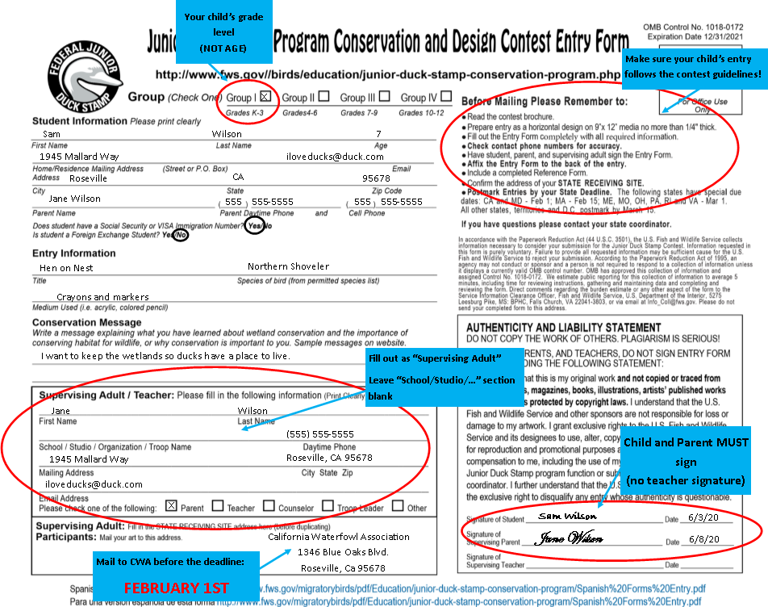
Example Entry Form

