Slide 1
Dichotomy Key Practice
Brought to you by California Waterfowl Association

Slide 2
Background Information
What does dichotomy mean?
The process of breaking down organisms into groups based on their characteristics or traits until reaching the individual organism.
What does a dichotomy key do?
It helps us identify organisms.

Slide 3
Background Information
How does it work?
The dichotomy key is a guide. As you follow along the guide’s instructions, it will place your organism into smaller and smaller groups until you are able to identify what invertebrate you have.
Why is important to be able to identify the different species?
It is important to be able to identify the different species of invertebrates because they are excellent indicators of water quality. We are able to see how good or not so good the water we are testing is based on the organisms we are able to collect and identify.

Slide 4
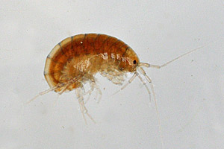
Let’s Practice
We are now going to practice identifying. We will start with this organism.
Looking at your chart, it starts by asking if the organism has a shell or no shell.
Looking at the organism, does it have a shell?

Slide 5
Let’s Practice
It does not have a hard shell like a mollusk (snails, clams, mussels).
So we follow along the chart where it says “No Shell” and answer the next question
Does it have legs, or does it not have any legs?

Slide 6
Let’s Practice
It does have legs, so we follow the line that says “Legs” and answer the next question
It is now asking for how many legs the organism has, looking at the organism, how many legs does it have?
Remember a pair is two legs, so if there are three pairs, that would be six legs total

Slide 7
Let’s Practice
Looking at the organism, we can see it has at least ten pairs of legs, possibly more
So we follow the line and see that the organism is one of the three organisms in this group.

Slide 8
Let’s Practice
Based on the drawings and the descriptions, which of the organisms in the 10+ legs group best fits this organism?

Slide 9
Let’s Practice
Based on the picture and the description, this organism is a SCUD.

Slide 10
Now it’s your turn
Now that you have had a little bit of practice, you are going to start identifying organisms on your own using the dichotomous key. This is practice for your field trip!

Slide 11
Directions
Break into pairs
Sharing your dichotomous key, work together quietly to identify the organisms on the screen
You will have one minute for each organism
Once you identify the organism, make sure to write the organism’s name on your worksheet
After everyone has completed the worksheet, everyone will trade papers to correct them.
Good Luck!

Slide 12
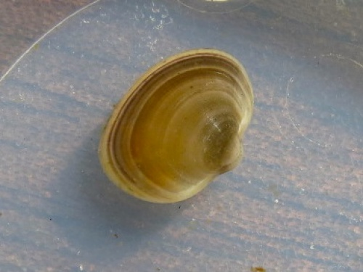
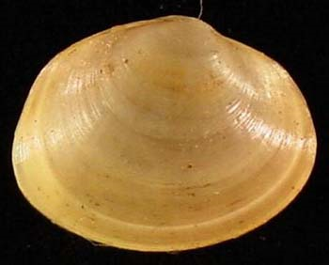
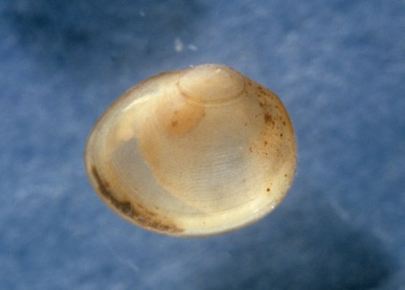
Who am i?
1.

Slide 13
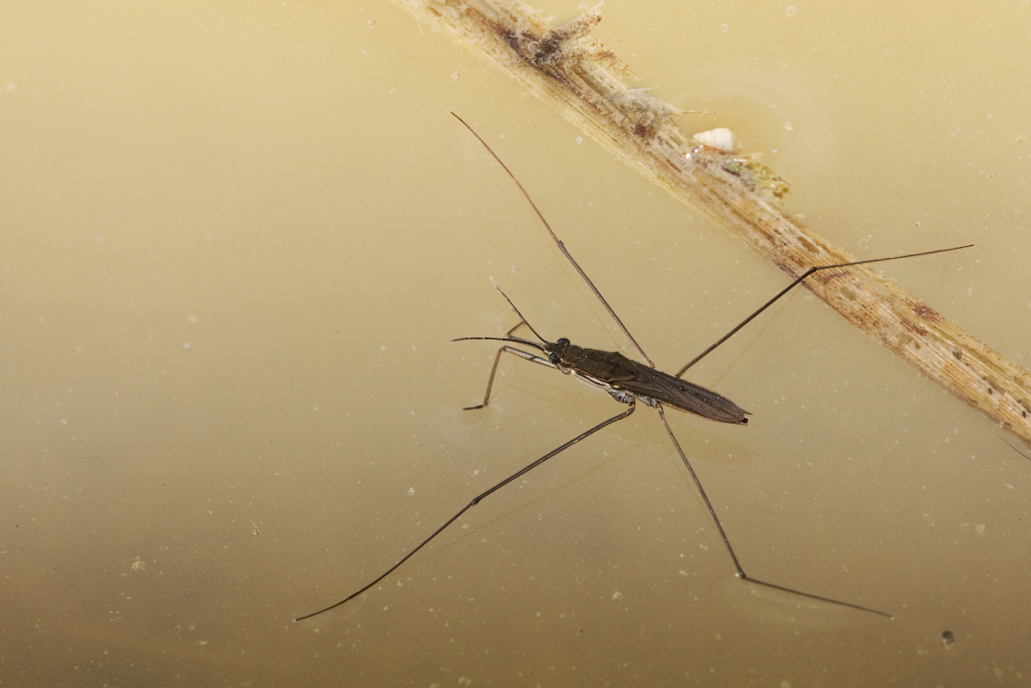
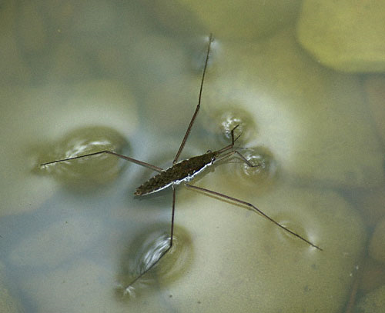
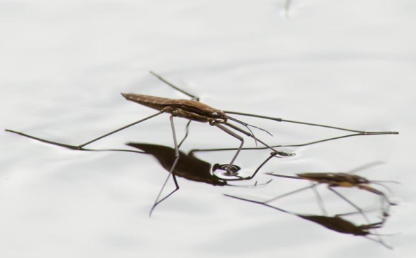
Who Am i?
2.

Slide 14
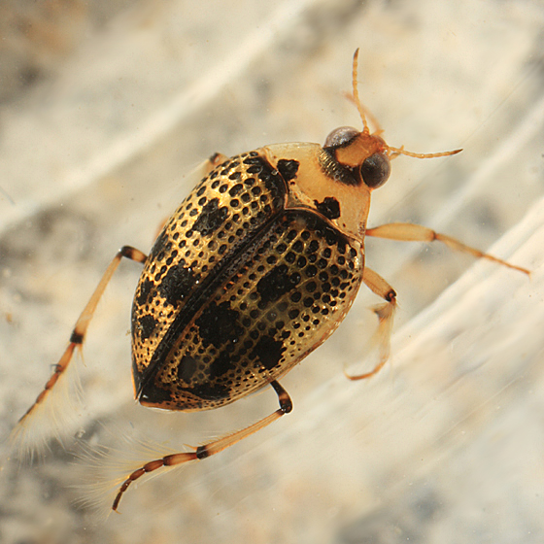
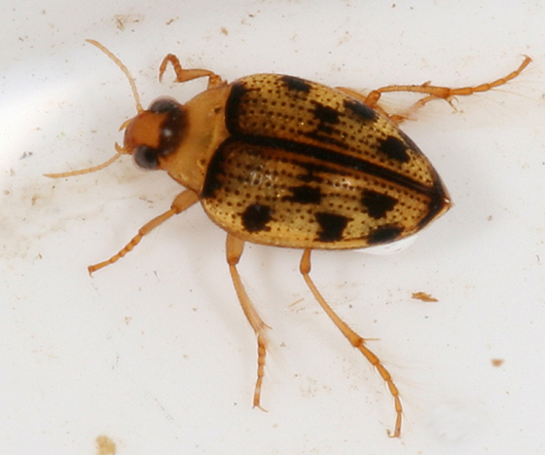
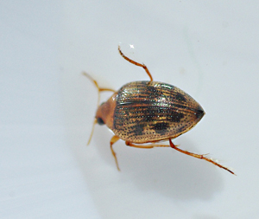
Who am I?
3.

Slide 15
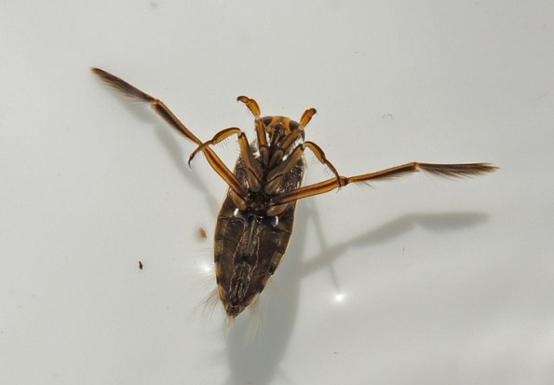
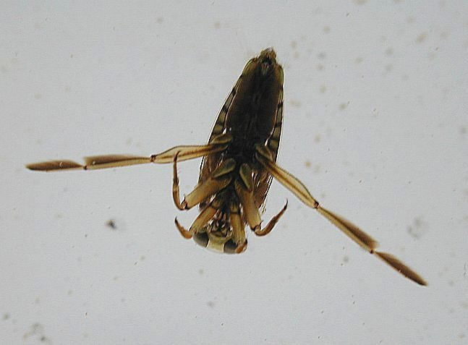
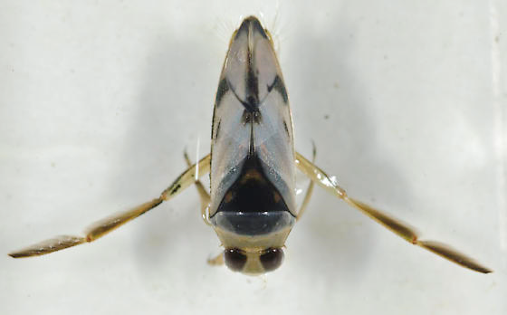
Who am i?
4.

Slide 16
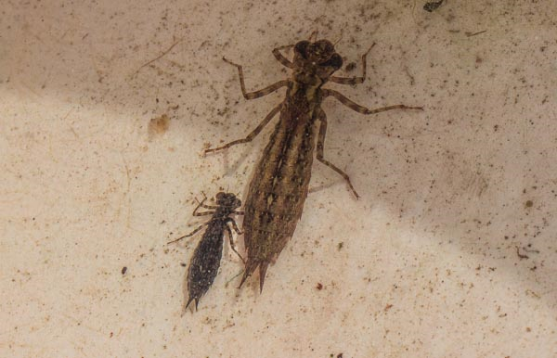
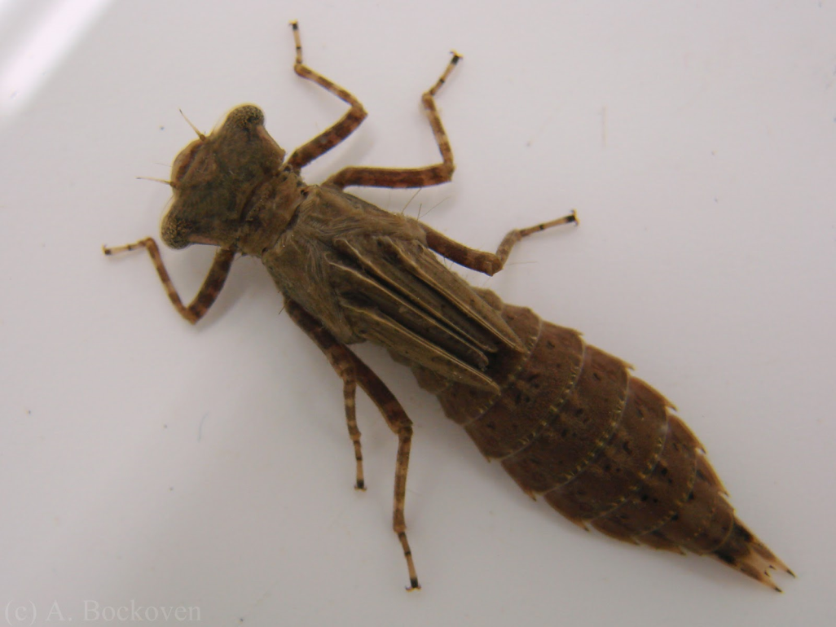
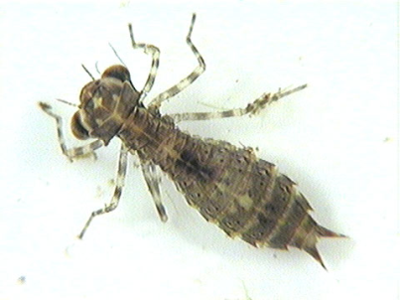
Who am i?
5.

Slide 17
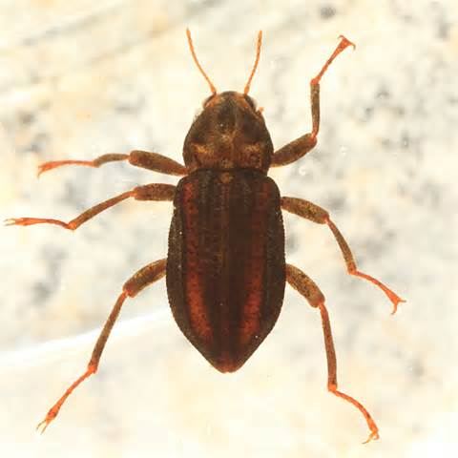
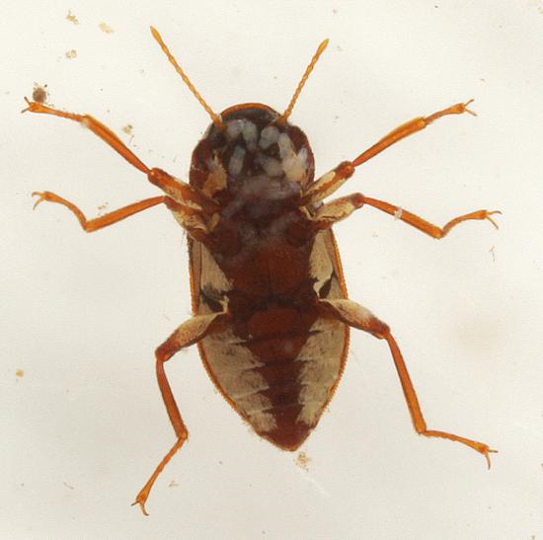
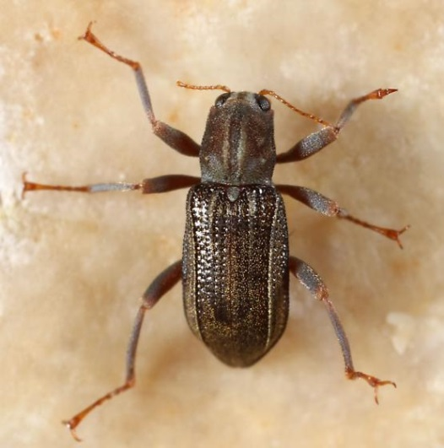
Who am i?
6.

Slide 18
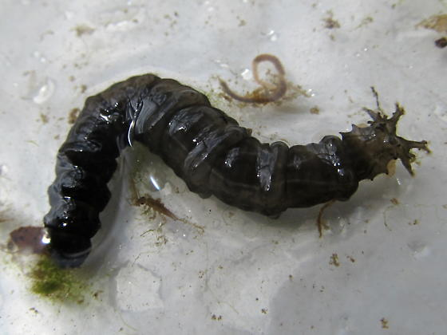
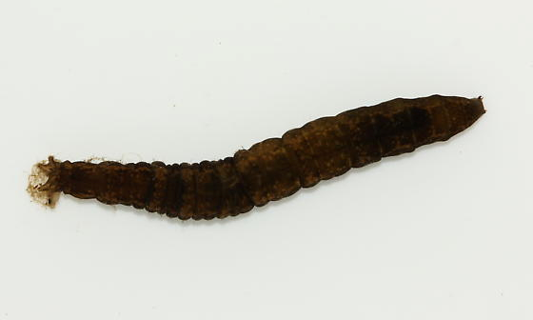
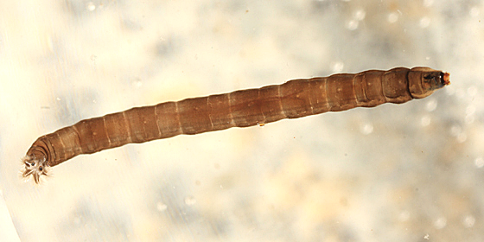
Who am i?
7.

Slide 19
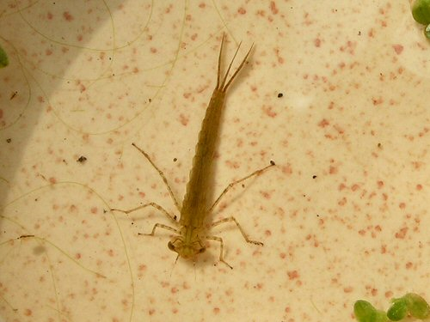
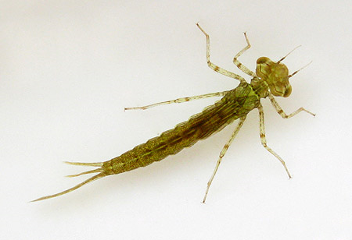
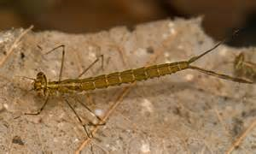
Who am i?
8.

Slide 20
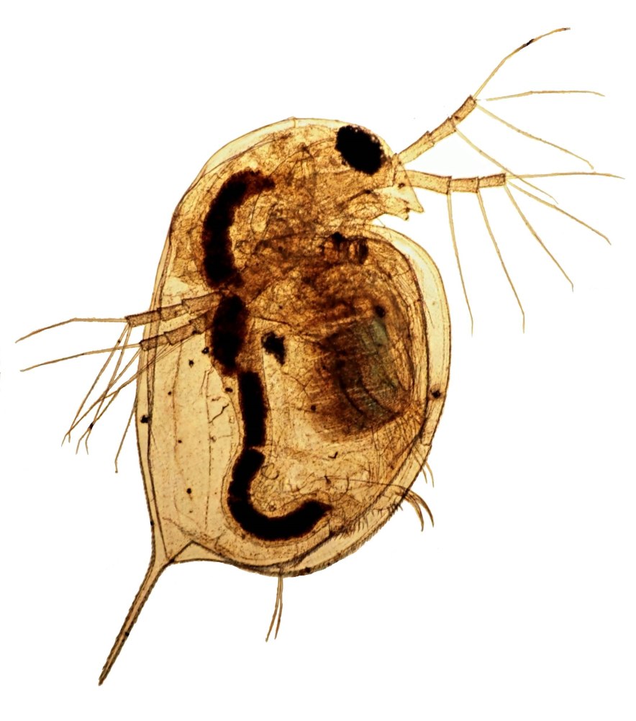
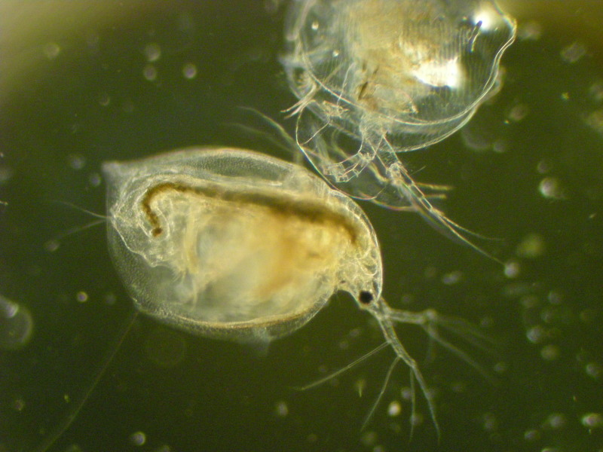
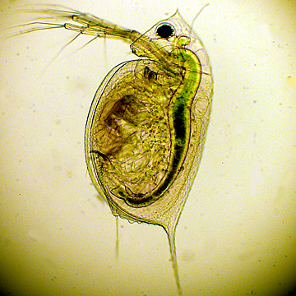
Who am i?
9.

Slide 21
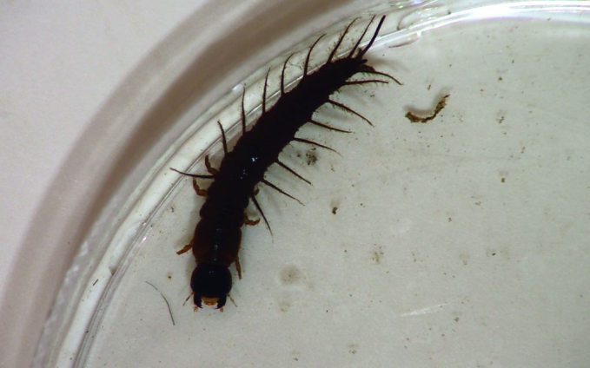
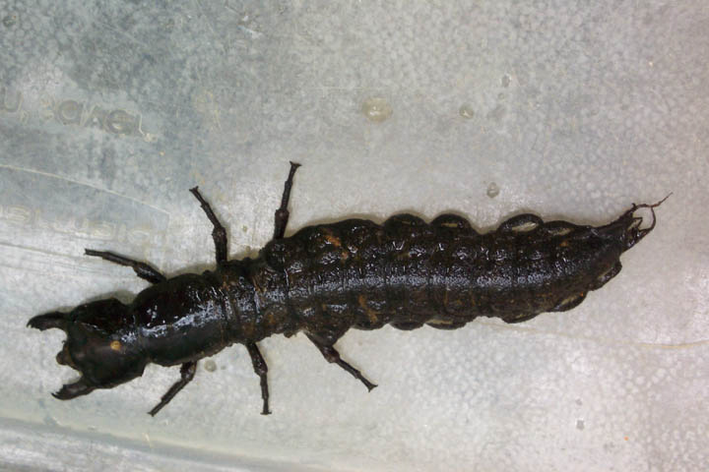
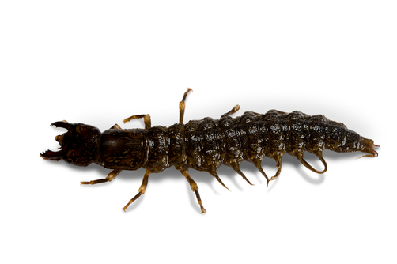
Who am i?
10.

Slide 22
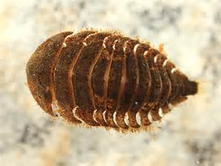
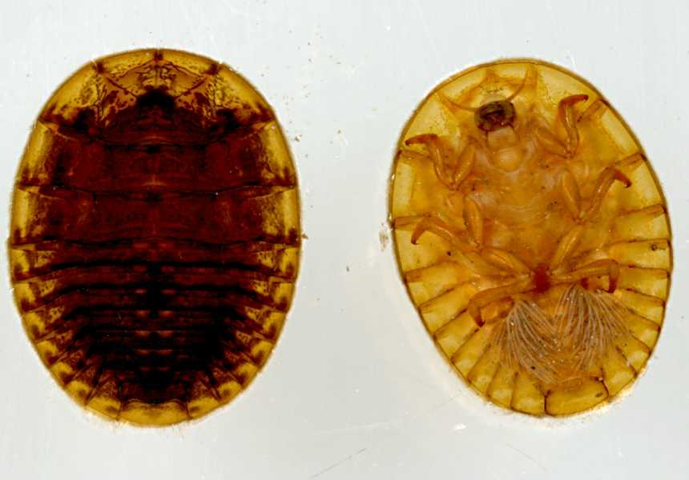
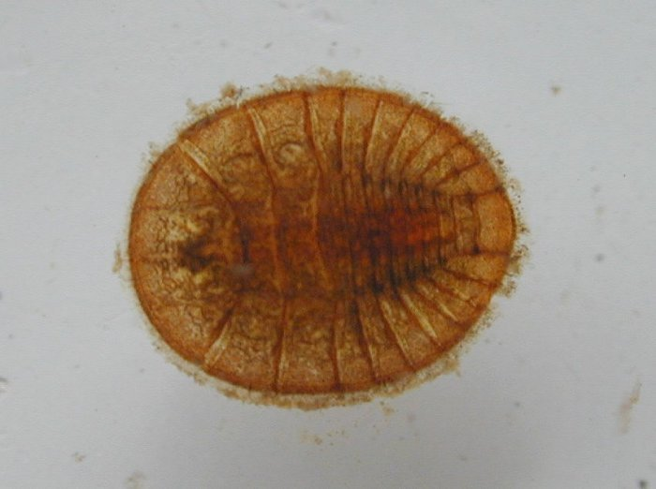
Bonus (1 point)

Slide 23
Time is up!
Let’s see how you did!
Take this moment to switch papers with another group to correct.
They get one point for each creature they get correct and one point extra if they get the bonus question correct.
At the bottom of the page write how many they got correct on the “Total” line

Slide 24
Fingernail clam
1.

Slide 25
Water strider
2.

Slide 26
Crawling water beetle
3.

Slide 27
Backswimmer
4.

Slide 28
Dragonfly larvae
5.

Slide 29
Riffle Beetle
6.

Slide 30
Cranefly larvae
7.

Slide 31
Damselfly larvae
8.

Slide 32
Daphnia (Water Flea)
9.

Slide 33
Dobsonfly larvae
10.

Slide 34
Water penny

Slide 35
Class Discussion
Which organism was the hardest to identify?
Why was it the hardest?
Why do we use dichotomy keys?
Why is it important to be able to identify different species of invertebrates?

